Slide 1
An Integrated Machine Learning Framework for Crop Selection, Fertilizer Suggestion, and Disease Diagnosis.
1602-21-737-015 DEEPTHI M
1602-21-737-058 SUCHITH B
Guide
C.Sireesha
Assistant professor

Slide 2
ABSTRACT
This project harnesses the power of machine learning to guide farmers in choosing the best crops and fertilizers, making agriculture more efficient and data-driven.
By analyzing key soil properties like N,P,K levels, pH, and rainfall, the system ensures that crops are selected based on what the land truly needs, rather than guesswork.
Using XGBoost, the model learns from real agricultural data, identifying patterns that help improve productivity and sustainability.
Instead of generic fertilizer use, the system suggests the right type and quantity based on soil deficiencies, promoting healthier soil and higher crop yield.

Slide 3
PROBLEM STATEMENT
This project aims to develop a Crop and Fertilizer Recommendation System using XGBoost and Random Forest to suggest the most suitable crop and fertilizer for cultivation.

Slide 4
RESEARCH PAPERS STUDIED
SNO | AUTHOR | APPROACH | HIGHEST ACCURACY
1 | Takalani Orifha Mufamadi | Knn, Random Forest, K-Star, Naive Bayes | 91.30%
2 | Priyadharshini A | Decision Tree, KNN ,Logistic Regression,SVM ,Naive Bayes | 95.00%
3 | Ashima Kukkar | Naive Bayes, Random Forest, SVM, KNN, Decision Trees | 97.07%
4 | Rakesh Kumar | KNN, Naïve Bayes ,Random Forest, K-Star | 96.00%
5 | A Mythili | KNN, Logistic Regression ,SVM ,Bagged Tree | 91.09%

Slide 5
SOFTWARE AND HARDWARE REQUIREMENTS
Hardware System Configuration:
Processor: 2 gigahertz (GHz) or faster processor.
RAM: 4 gigabyte (GB) for 32-bit or 4 GB for 64-bit.
Hard disk space: =>16GB.
Software Configuration:
Operating System: Windows XP/7/8/8.1/10, Linux and Mac
Coding Language: Python
Tools: Pandas, Numpy ,Seaborn , Pickle,Scikit-learn, Pytorch
Framework: Flask
Other Tools : HTML, CSS, Bootstrap

Slide 6
EXISTING METHOLOGY
Random Forest
Data Preprocessing : Handling missing values, normalizing data.
Feature Selection : Identifying the most important parameters for crop prediction.
Model Training:
The algorithm creates multiple decision trees using random subsets of data.
Each tree makes an independent prediction.
The final crop recommendation is determined using majority voting or averaging.
Hyperparameter Tuning : Adjusting the number of trees, depth, and features considered per split for optimal performance.
Prediction : Given new soil and environmental conditions, the model predicts the best crop based on the trained trees.

Slide 7
PROPOSED METHODOLOGY
For Crop Recommendation:
XGBOOST
Data Preprocessing: Cleaning and normalizing the dataset.
Feature Selection: Identifying the most import soil and climate parameters for crop prediction.
Model Training: XGBoost builds multiple decision trees sequentially, minimizing errors using gradient boosting.
Hyperparameter Tuning: Optimizing learning rate, max depth, number of estimators, etc., for better performance.
Prediction: Given new soil and environmental conditions, the model recommends the best crop.

Slide 8
For Fertilizer Recommendation:
a) Random Forest Classifier
A bagging-based ensemble method that builds multiple decision trees.
Each tree is trained on a random subset of data.
The final prediction is made using majority voting or averaging.
b) XGBoost Classifier
A boosting-based ensemble method that builds decision trees sequentially.
Each new tree corrects the errors made by previous trees.
Uses regularization to reduce overfitting and improve performance.
c) Voting Classifier (Soft Voting)
Combines Random Forest and XGBoost into a single model.
Uses soft voting, meaning it takes the predicted probabilities from both models and averages them to make the final decision.
This improves accuracy and stability by leveraging the strengths of both models.

Slide 9
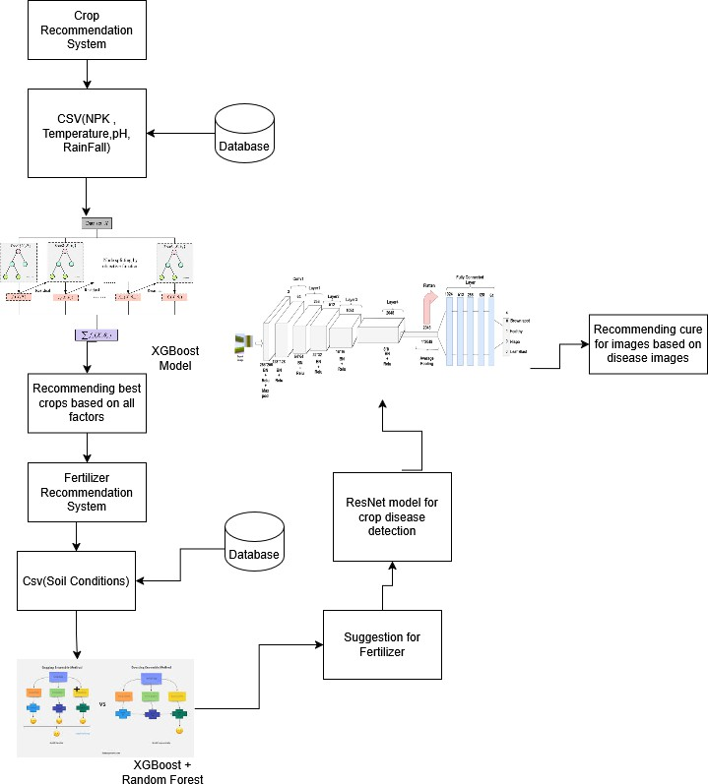
ARCHITECTURE DIAGRAM

Slide 10
DATASET DESCRIPTION
Crop recommendation dataset: This dataset is obtained from Kaggle. It contains the following data fields Data fields
N - ratio of Nitrogen content in soil P - ratio of Phosphorous content in soil K - ratio of Potassium content in soil temperature - temperature in degree Celsius humidity - relative humidity in % ph - ph value of the soil rainfall - rainfall in mm Fertilizer Recommendation Dataset : This data set is obtained from Kaggle It contains the following data fields Data Fileds Crop - Type of crop N - Ratio of Nitrogen content in soil P - ratio of Phosphorous content in soil K - ratio of Potassium content in soil pH - pH value of soil Soil Moisture - amount of moisture in soil

Slide 11
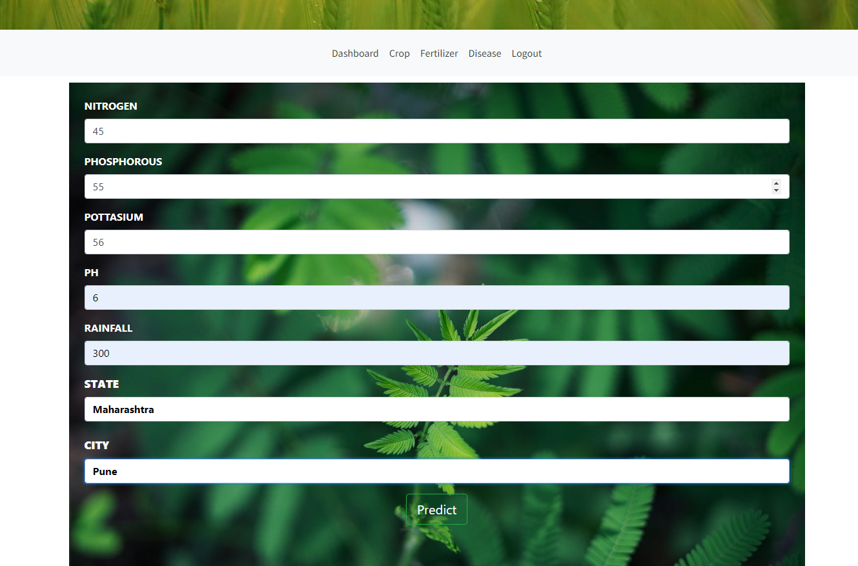
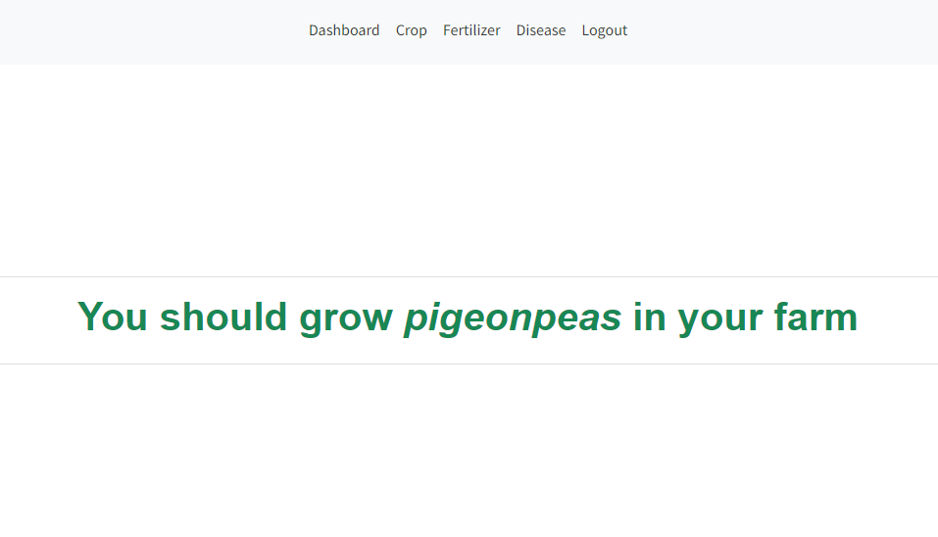
OUTPUT
Input page for Crop Prediction
Predcition of crop

Slide 12
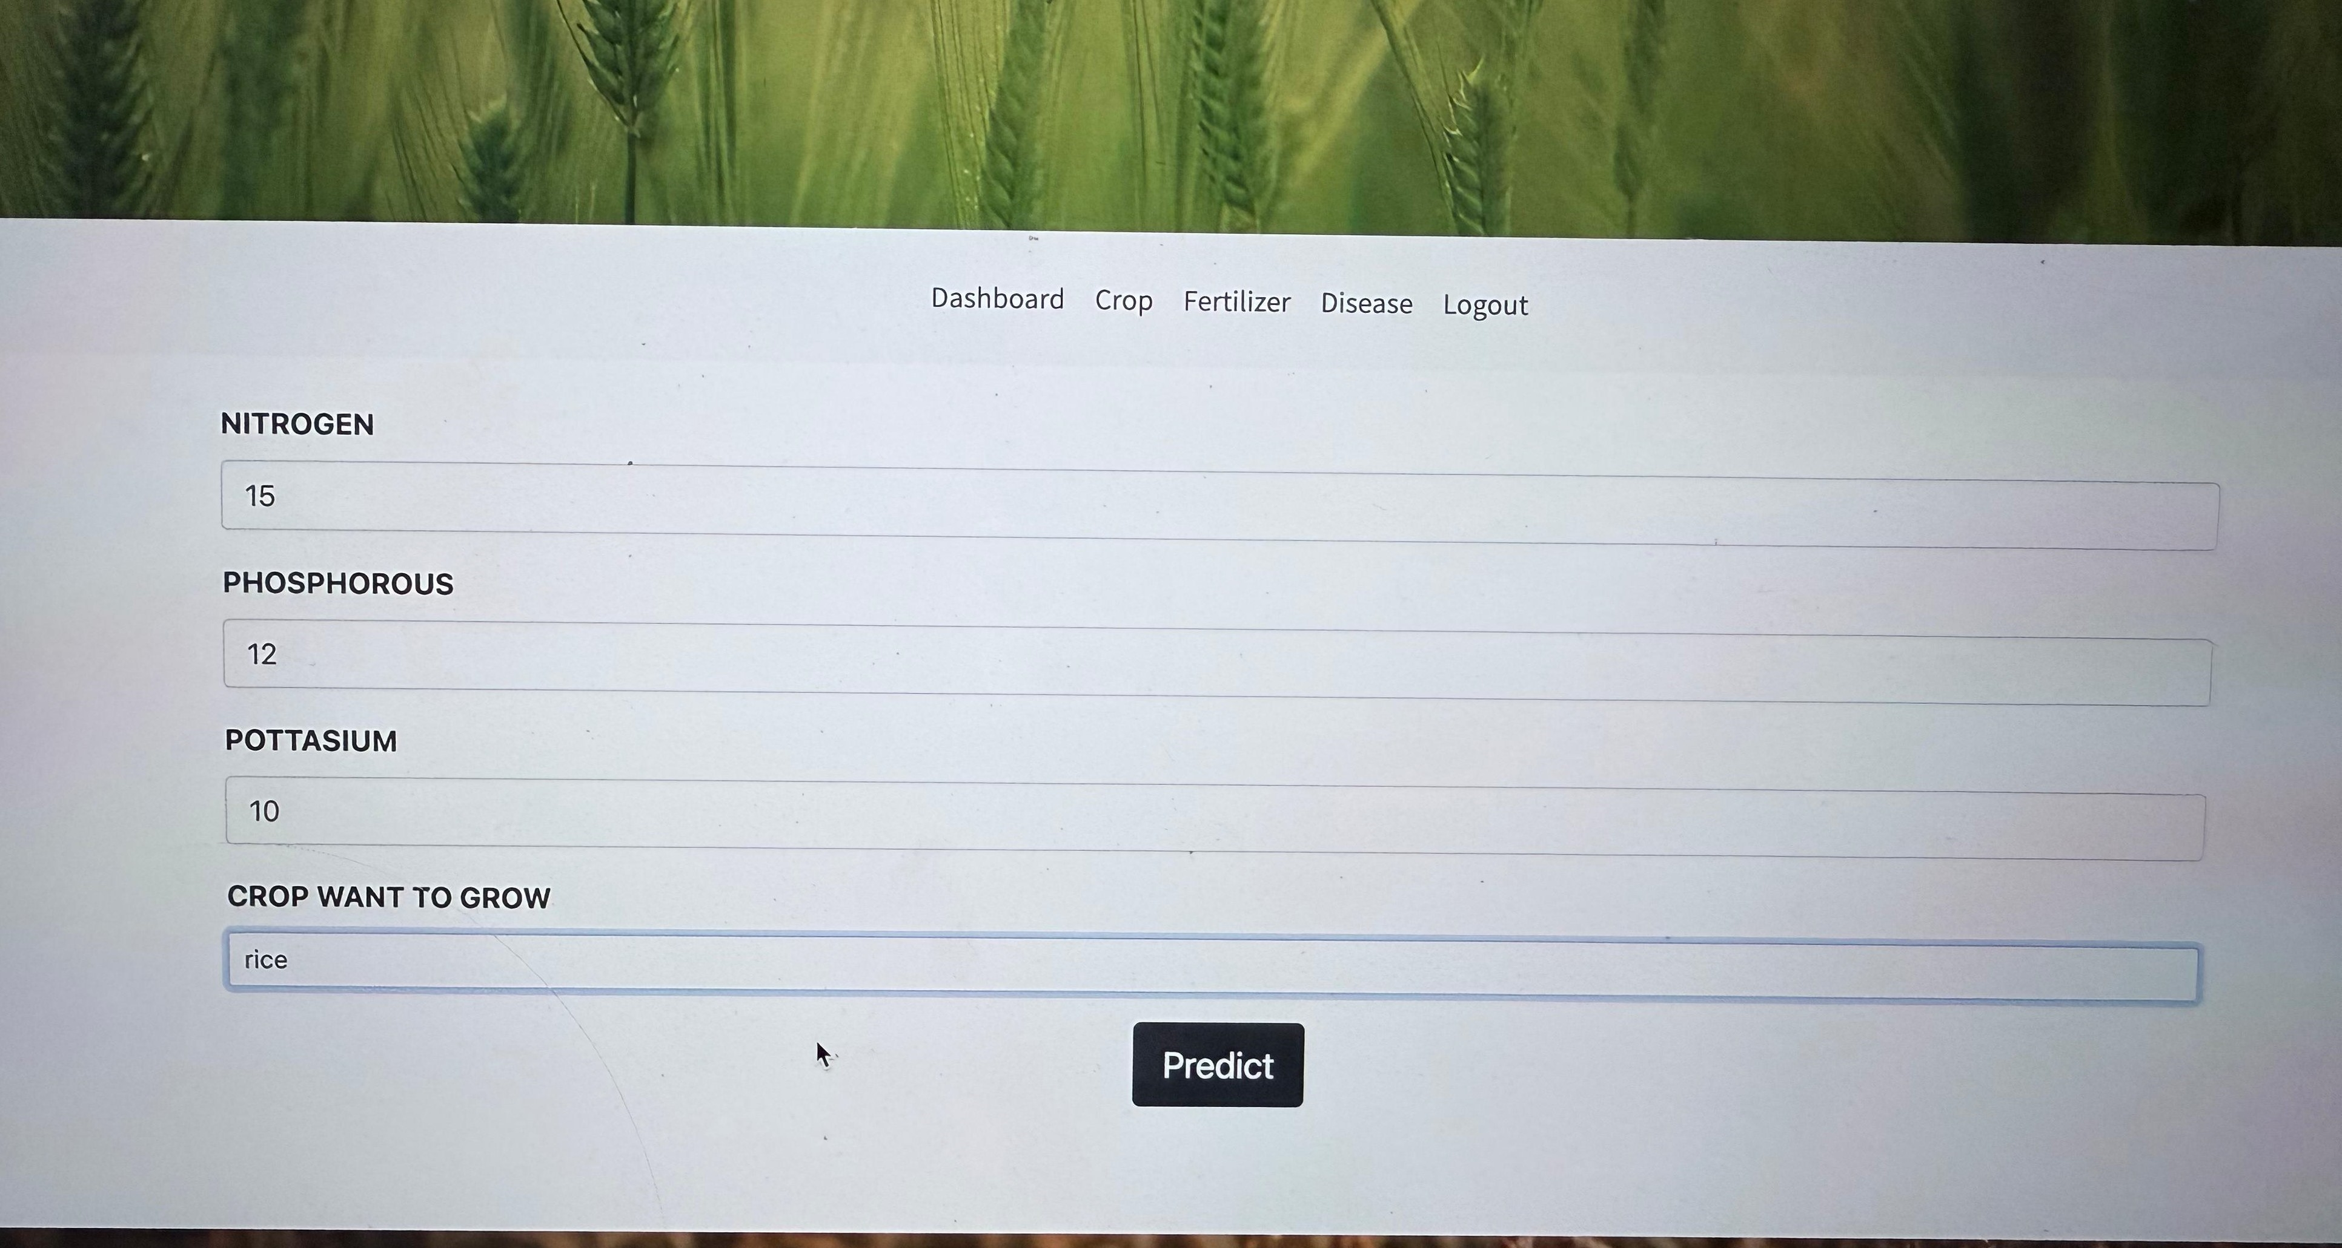
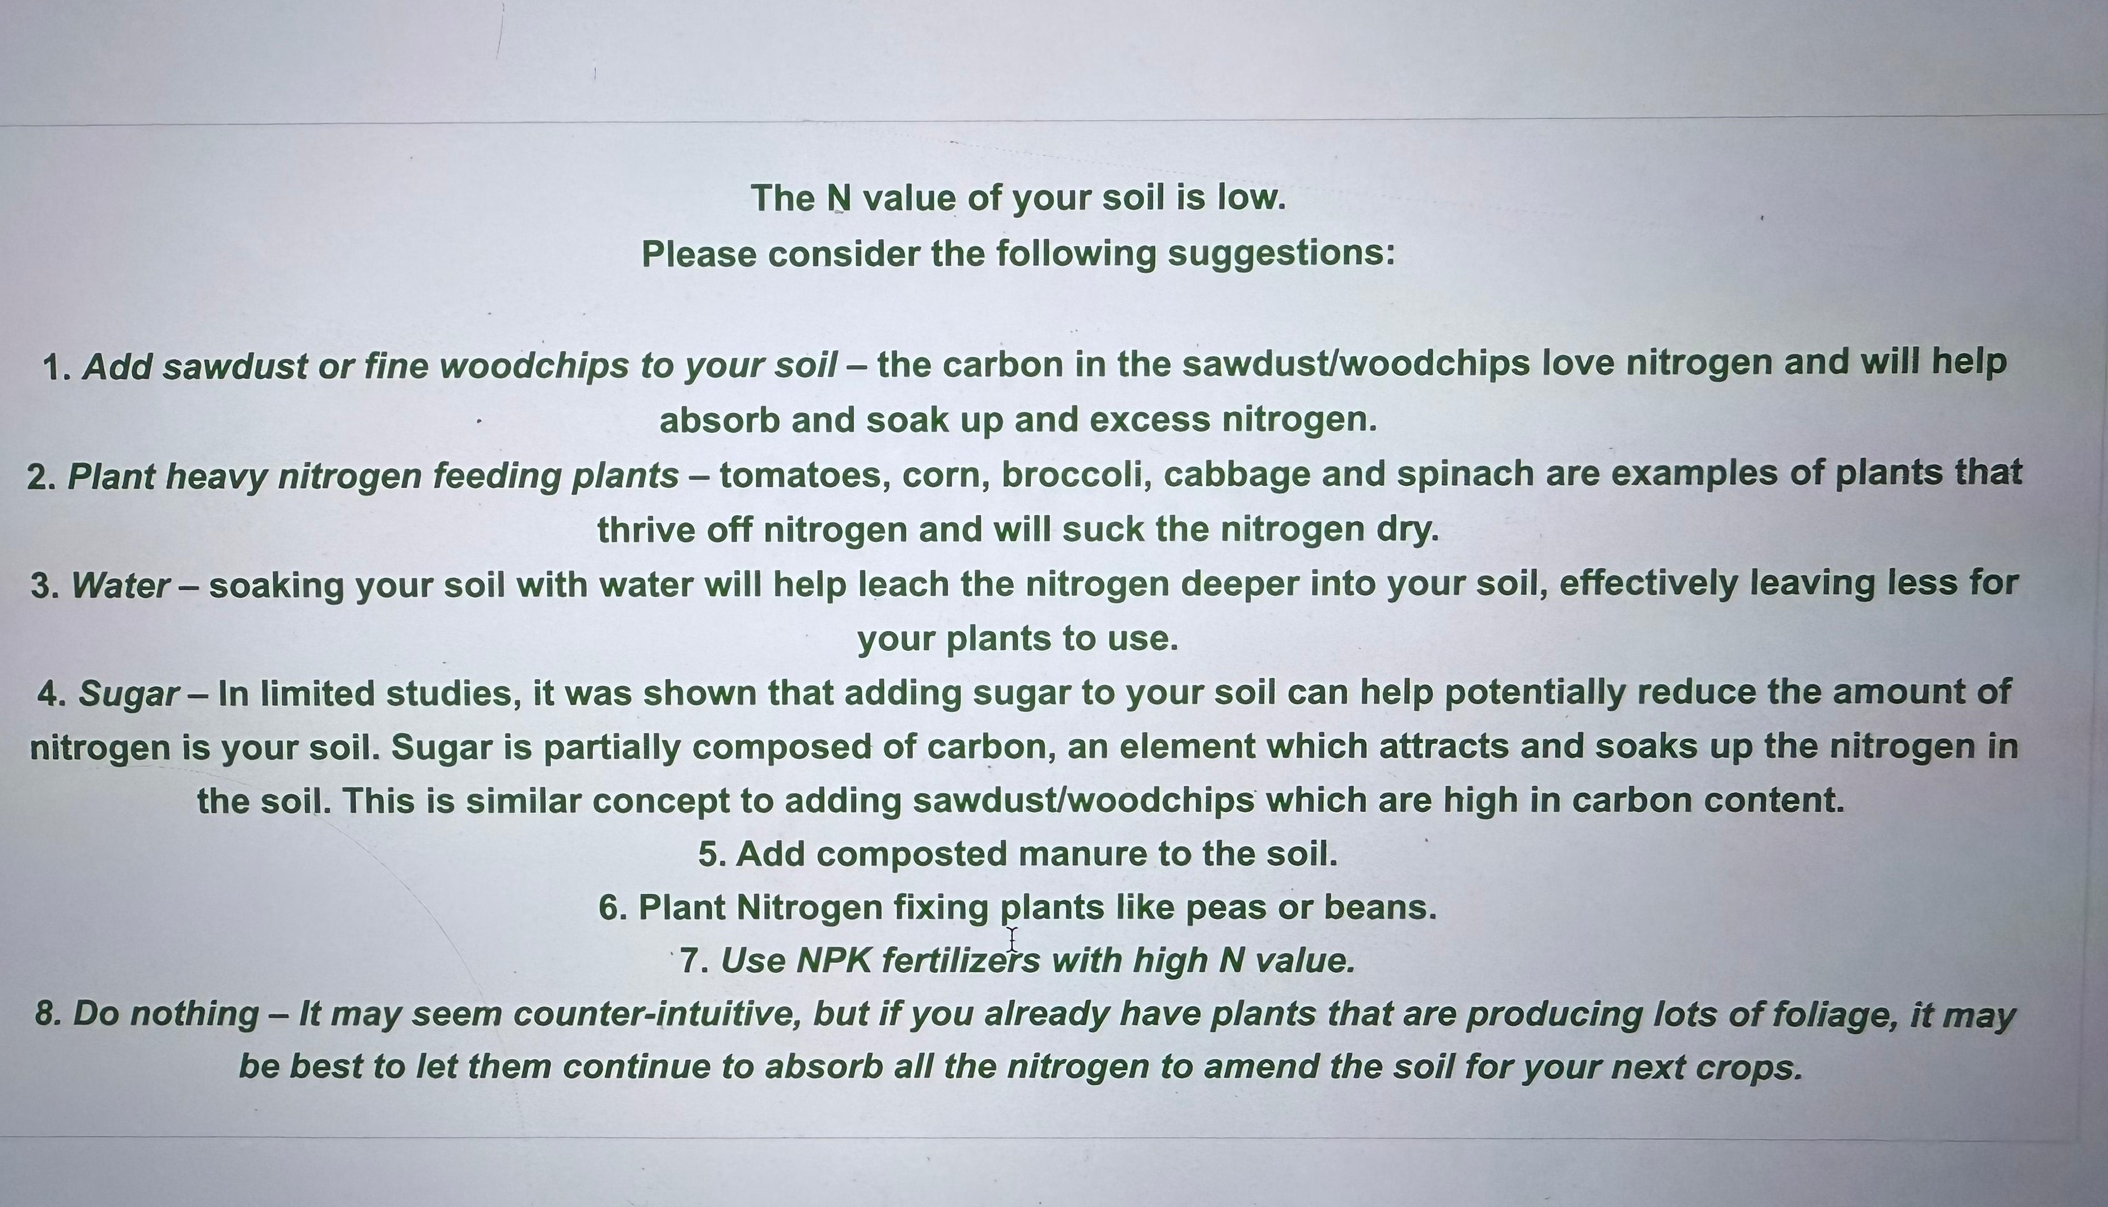
Input page for Fertilizer recommendation
Recommendation of fertilizers

Slide 13
Results
Model | Accuracy
XGBoost | 99.09%
Random Forest & XGBoost | 95.55%

Slide 14
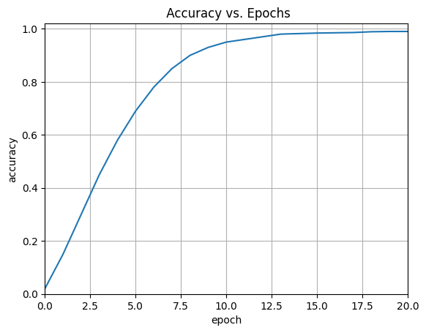
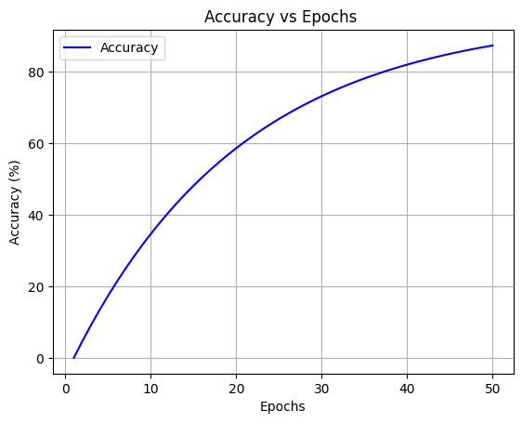
Accuracy vs epochs graph for Random Forest and XGBoost
Accuracy vs epochs graph for XGBoost

Slide 15
REFERENCES
[1]Takalani Orifha Mufamadi, Ritesh Ajoodha, Crop Recommendation using Machine Learning Algorithms and Soil Attributes Data.
[2] 10th International Conference on Computing, Communication and Networking Technologies, “Low-cost IOT+ML design for smart farming with multiple applications”, Fahad Kamraan Syed, Agniswar Paul, Ajay Kumar, Jaideep Cherukuri.
[3] 2019 IEEE “ Smart Management of Crop Cultivation using IoT and Machine Learning” Archana Gupta, Dharmil Nagda, Pratiksha Nikhare, Atharva Sandbhor
[4] Radhika, Narendiran, “Kind of Crops and Small Plants Prediction using IoT with Machine Learning,” International Journal of Computer & Mathematical Sciences.
[5] “Crop Recommendation on Analyzing Soil Using Machine Learning” Anguraj.Ka, Thiyaneswaran.Bb, Megashree.Gc, Preetha Shri.J.Gd, Navya.Se, Jayanthi. Jf.
[6] “Classification of Soil and Crop Suggestion using Machine Learning Techniques”, A. Mythili , IEEE 2019.
[7] Mehta, P., Shah, H., Kori, V., Vikani, V., Shukla, S., & Shenoy, M.,2018. “Survey of unsupervised machine learning algorithms on precision agricultural data”, IEEE
[8] “IOT based Crop Recommendation, Crop Disease Prediction and Its Solution” Rani Holambe, Pooja Patil, Padmaja Pawar, Saurabh Salunkhe , Mr. Hrushikesh Joshi, 2019 IRJET

Slide 16
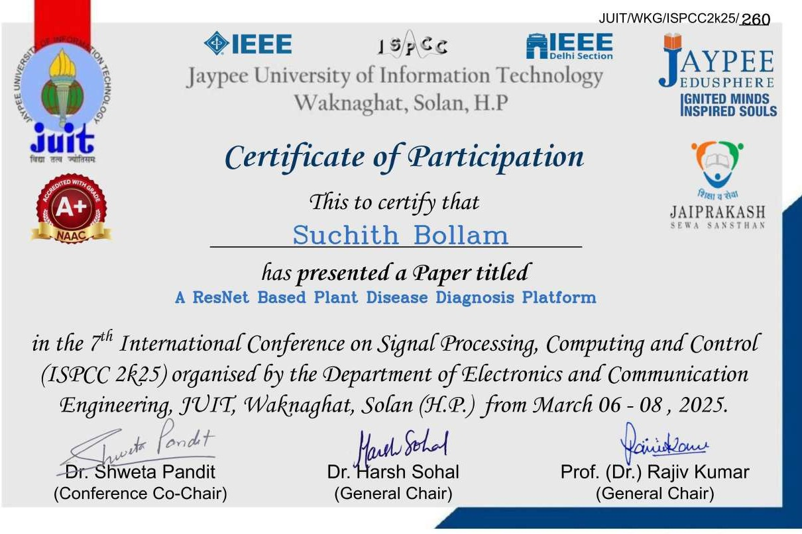
PUBLICATION STATUS
We published our previous work titled "A ResNet Based Plant Disease Diagnosis Platform" in the 7th International Conference on Signal Processing, Computing and Control (ISPCC 2k25), organized by the Department of Electronics and Communication Engineering, JUIT, Waknaghat, Solan (H.P.), from March 6–8, 2025.

Slide 17
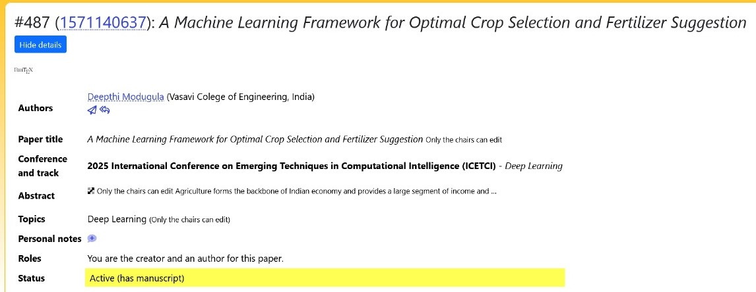
We have submitted a research paper titled “A ResNet Based Plant Disease Diagnosis Platform” to the International Conference on Emerging Techniques in Computational Intelligence (ICETCI 2025), and the acceptance decision is currently pending.For the current work we have submitted a paper

